Slide 1
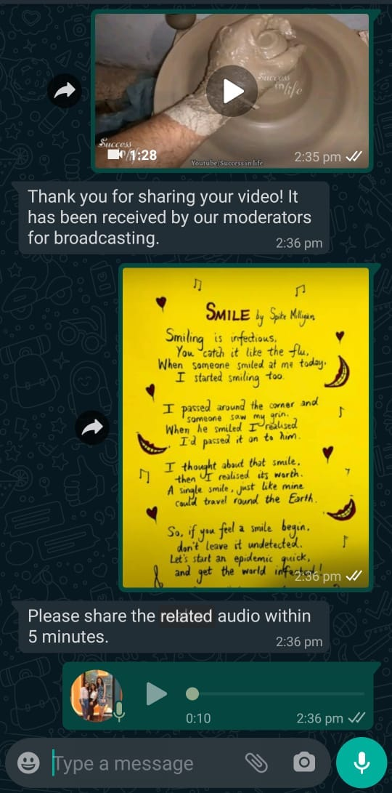
Demo: A WhatsApp Bot for Citizen Journalism in Rural India
Introduction
complements IVR systems
Functionalities
Receive audio, video and image stories
Send location, phone number based recent stories
WhatsApp preferred over App
Update of recent stories
Results for 7 weeks:
396 stories received, 140 published
30 unique users
Road Ahead:
Moderator Mode
Recommendation System
Priyanka Verma, Ananya Saxena, Alok Sharma, William Thies, Devansh Mehta

